Slide 1



UNINA AEROSPACE SYSTEMS TEAM
Research Activities
  October, 2021

Slide 2









Aerospace Systems Team
Current Staff: 2 Full Professor, 4 Associate, 2 Assistant Professors, 1 Post-Doc Researchers and 10 PhD Students
Prof.Antonio Moccia
Prof.Michele Grassi
Prof. Giancarlo Rufino
Prof. Giancarmine Fasano
Prof. Domenico Accardo
Prof. Alfredo Renga
Assistant Professors
Post-Doc
Researcher
Maria Daniela Graziano, PhD
Roberto Opromolla, PhD
Flavia Causa, PhD
More than 30 years track record of funded projects in aerospace systems technology and applications

Slide 3



UNINA-DII Aerospace Eng.
World Ranking Placement
UNINA Aerospace Engineering is at the fifth place among all European Universities
(first in Italy) according to the Academic Ranking of World Universities (ARWU) - Shanghai World Ranking 2021 – (first in Italy in 2019 too, and second in 2018 e 2020)

Slide 4


UNINA-DII Aerospace System Team – National Placement
The disciplinary scientific sector ING-IND/05 Aerospace Plants and Systems (classification of the Italian Ministry of University and Research,) at the University of Naples Federico II was in the first position of the ranking among all Italian universities where it is present both in the 2004-2010 VQR (Quality Assessment of Research) and the 2011-2014 VQR conducted by ANVUR (Italian National Agency for Evaluation of the University System and of Research). Results for 2015-2019 VQR shall be issued next year.

Slide 5
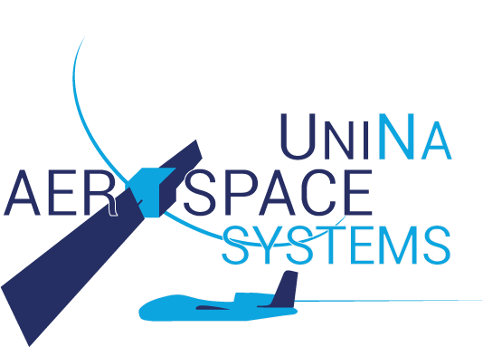
Research Activities
UNMANNED AERIAL SYSTEMS
Advanced avionics and payloads for UAS
Autonomous take-off and landing systems
Detect and avoid architectures and algorithms
Autonomous GNC for UAS and re-entry vehicles
SPACE SYSTEMS
GNC and AOCS advanced techniques and Technologies
Space mission design based on small and micro platforms
Space Situational Awareness/Space Surveillance and Tracking
REMOTE SENSING AND SYNTHETIC APERTURE RADAR
Bistatic and distributed SAR by formation flying satellites
Algorithms and techniques for marine and maritime SAR application
Deep learning techniques and solutions for SAR image analysis

Slide 6
Research Activities
REMOTE SENSING AND SYNTHETIC APERTURE RADAR
Bistatic and distributed SAR by formation flying satellites
Algorithms and techniques for marine and maritime SAR application
Deep learning techniques and solutions for SAR image analysis

Slide 7
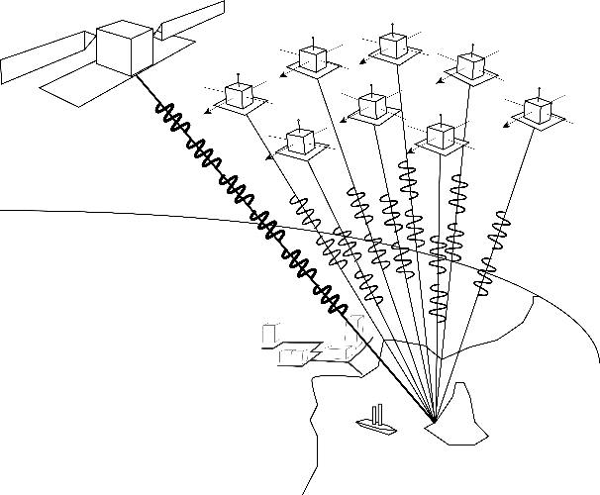
Distributed SAR concept
Distributed SAR is a versatile remote sensing concept based on a multi-platform system of synthetic aperture radars
The term Formation Flying Synthetic Aperture Radar (FF-SAR) is used to indicate a cluster of satellite receivers flying in a close formation
  Each receiver collects the signal(s) emitted from the transmitter(s) and scattered from the area of interest
  The cluster of an FF-SAR can include the transmitter or, alternately, can be composed of parasitic platforms receiving the signal of a separate illuminator
  Each receiving unit, as an isolated entity, can be used to generate a bistatic SAR image

Slide 8
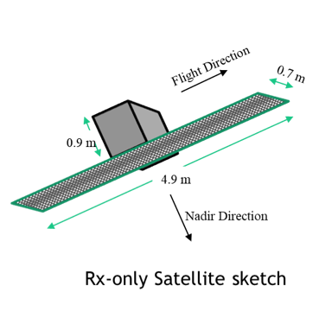

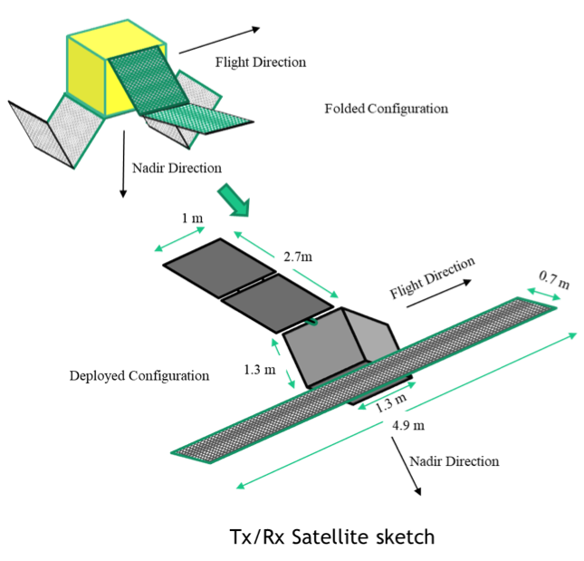
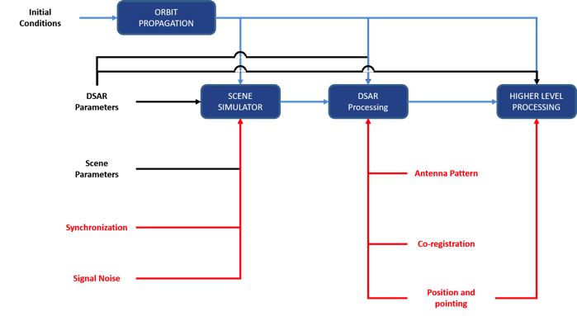
Distributed SAR Project and Collaborations
Project Title | DISTRIBUTED MICRO-SATELLITE-BASED SAR PERFORMANCE STUDY (2017-2018)
Funded by | DSO National Laboratories, Singapore
DSAR Simulation Environment
DSAR Demonstrator Concept

Slide 9
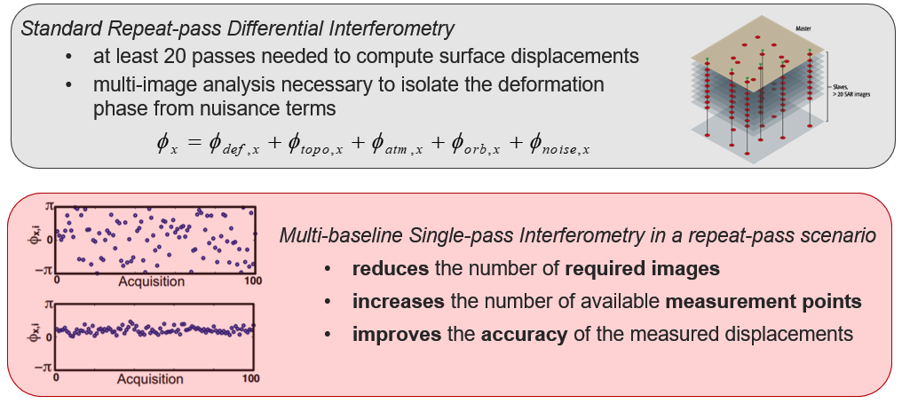
Distributed SAR Project and Collaborations
GLIDE (HiGhLy SensItive Radar Change DEtection) project, 2019-2021, funded by the Italian Ministry of Defense in the framework of PNRM program
  Activities coordinate with Isreali Ministry of Defence (MAFAT)
  UAV swarms for radar change detection
  FF-SAR by satellite formations for multi-baseline single-pass interferometry in a repeat-pass scenario

Slide 10
Distributed SAR Project and Collaborations
FORCE (FORmation flying of CubEsat assemblies for remote sensing) project, funded by the MUR, University of Naples Prime Contractor
FORCE concept is based on a fleet of formation-flying platforms (12U CubeSat) to implement FF-SAR observation modes and system/platform modularity concept
The objective is twofold:
  Enhancement of monolithic SAR performance by exploiting FF-SAR principle
  Application of the modularity paradigm to system/platform design to make them suitable for different mission settings
Along track Cluster (size <1000 m)

Slide 11
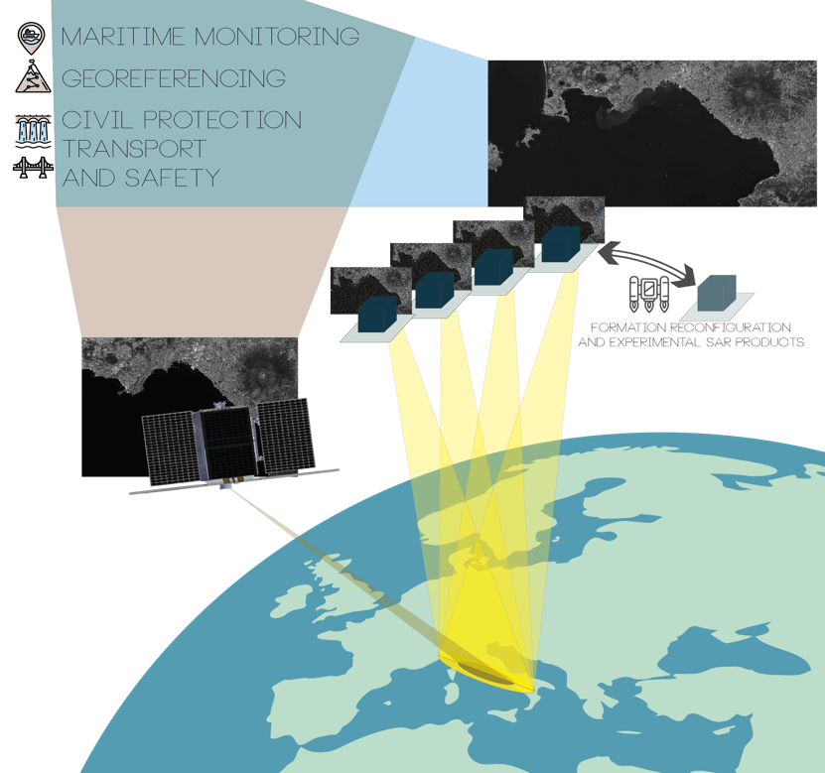
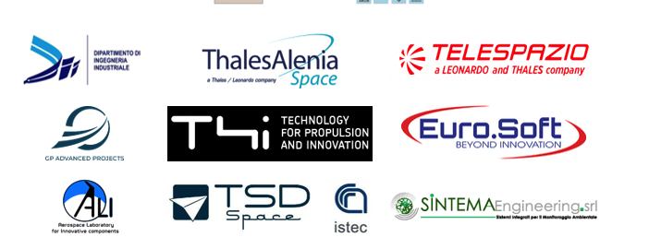

Distributed SAR Project and Collaborations
The team coordinated RODiO mission proposal submitted to the ASI call for future cubesat missions in November 2020
RODiO exploits the principle of distributed SAR to produce high-quality bistatic SAR image supporting applications and services by a cluster of CubeSats
RODiO Phase A/B selected for funding by ASI

Slide 12
SAR-based Maritime Monitoring
Integrated AIS-SAR System for Maritime Surveillance
(PNRM contract with Italian Ministry of Defense, 2013-2014)
Activity focused on maritime surveillance by using spaceborne SAR systems to detect ships, adequately supported by in-situ information to select legal ships and identify potential alarms
Project goals included:
Development, implementation, and validation of ship and ship-wake detection algorithms on SAR data
Integration of SAR-derived information in an automatic system for sea traffic monitoring
Analysis and design of satellite constellations for maritime monitoring by SAR and satellite AIS

Slide 13
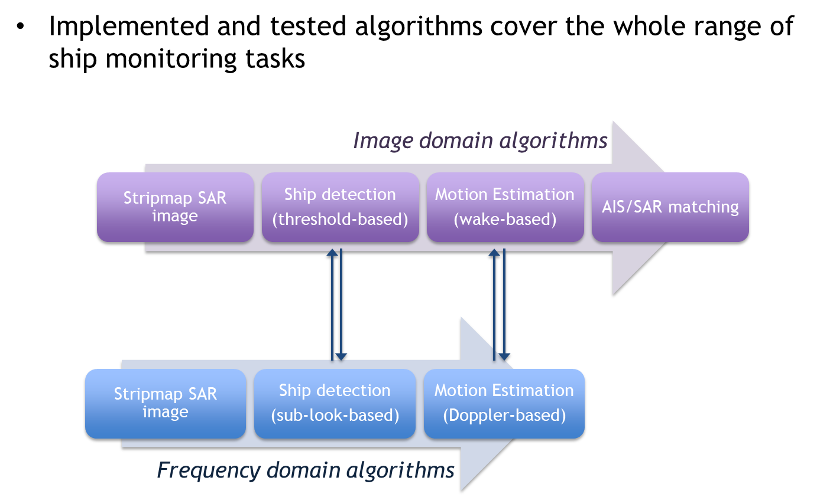
SAR-based Maritime Monitoring

Slide 14
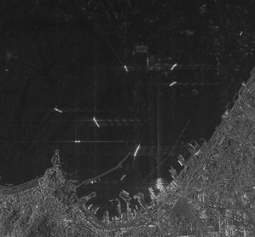
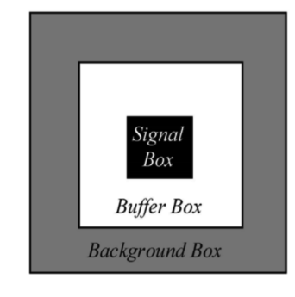
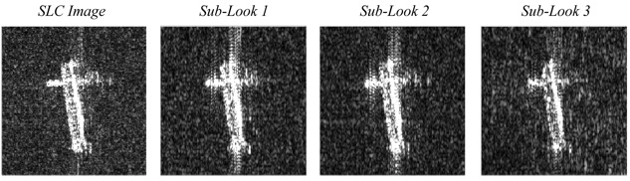
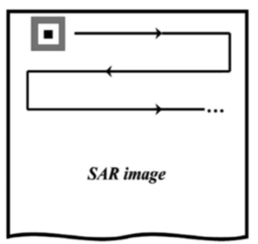
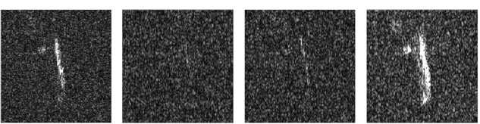
Ship Detection
ADAPTIVE THRESHOLD DETECTOR
SUB-LOOK ANALYSIS

Slide 15
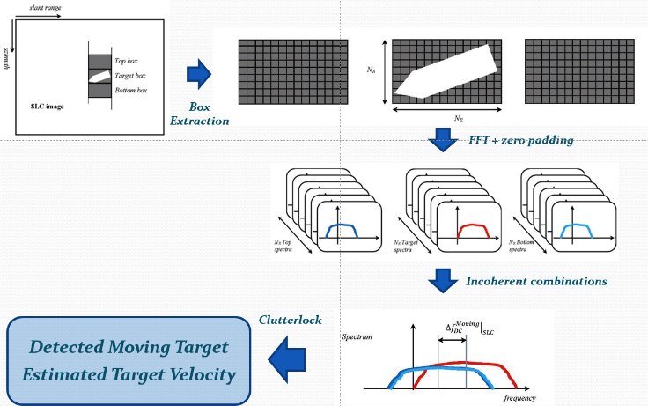
Ship Velocity Estimation
DOPPLER ANALYSIS FOR VELOCITY ESTIMATION

Slide 16
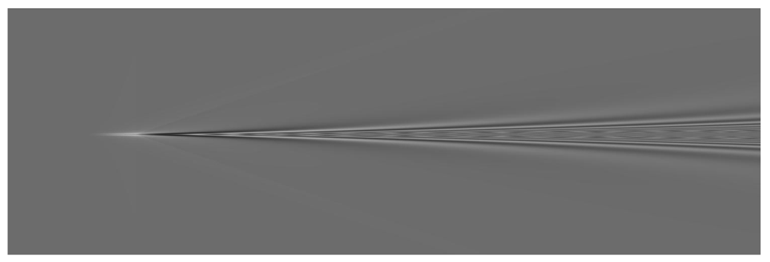
Detection of non-collaborative non-visible ships
Illegal activities like transportation of drugs or other goods typically conducted at night by so-called go-fast ships, pangas, speed boat
  High speed (up to 80 knots)
  Made of fiberglass
  …but generate long visible wakes
Automatic wake detection mandatory for Maritime Situational Awareness
  Very challenging if the vessel is not imaged
  Several other phenomena can generate similar features in SAR images, e.g. oil spill, natural surface films, locally reduced wind speed, etc
Wake from go-fast boat at 30 m/s

Slide 17
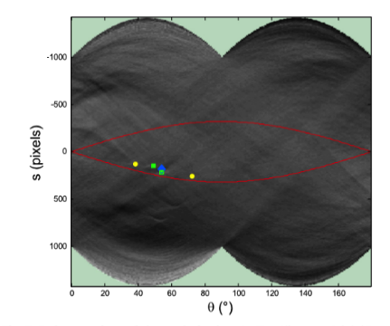
Automatic Wake Detection – Non-visible ships
Radon-based approach
Search
Detection
Reconstruction
High detection rate with negligible false alarms over areas with homogenous wind field
Natural surface films or transitions from high to low winds speed regions affect detection performance

Slide 18
Automatic Wake Detection
Convolutional Neural Networks
SAR Ship Wake Dataset (SSWD) developed
  261 wake chips with 291 labelled wakes
  Sentinel-1 IW RGD VV images
  Highly congested areas, e.g. Strait of Gibraltar, Egadi Islands (Italy), the Gulfs of Genoa and Naples (Italy), the English Channel, and the Liaodong Bay (China)
Different object detection models tested
  Best performance achieved by Cascade Mask R-CNN with ResNet50 backbones

Slide 19





Ongoing Projects
COntrol of coastal Areas by SAR data and multimission/multifrequency Techniques (COAST) 18-month project funded by the Italian Space Agency
Experimental verification of the added value of multi-mission/multi-frequency SAR data for monitoring
  protected marine areas
  areas affected by illegal fishing
  areas affected by smuggling

Slide 20

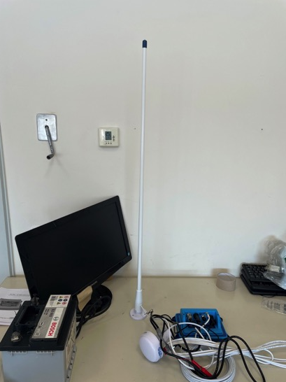
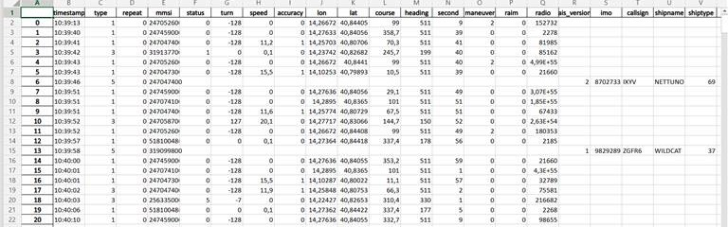
Ongoing Projects
ARGO - A wake Revelation system for GO-fast vessels
Duration: 12 Months
Funded by University of Naples Federico II
Aims:
  define the structure of the wake under different sea- and ship-related conditions
  improve and test a deterministic approach for wake confirmation
  estimate the operational utilization of the proposed technique

Slide 21
Research Activities
SPACE SYSTEMS
GNC and AOCS advanced techniques and Technologies
Space mission design based on small and micro platforms
Space Situational Awareness/Space Surveillance and Tracking

Slide 22
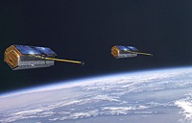
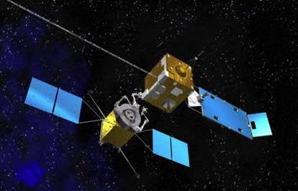
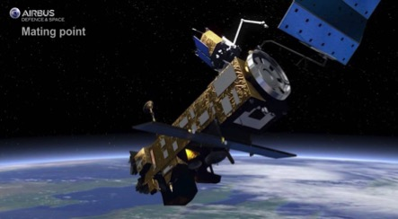
Autonomous GNC for future space operations
Next-generation space missions can be enabled by enhancing the level of autonomy of spacecraft
Need to develop advanced functionalities of relative Guidance, Navigation and Control
The activities of our research group focus on
Formation Flying (FF)
GNSS-based
On Orbit Servicing (OOS)
Relative trajectory design and control (satisfy safety requirements and optimize performance)
EO-based
Autonomous relative navigation approaches (enable close-proximity maneuvers around cooperative and non-cooperative spacecraft)
Active Debris Removal (ADR)

Slide 23
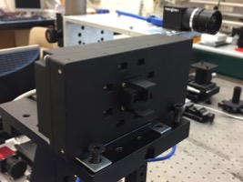
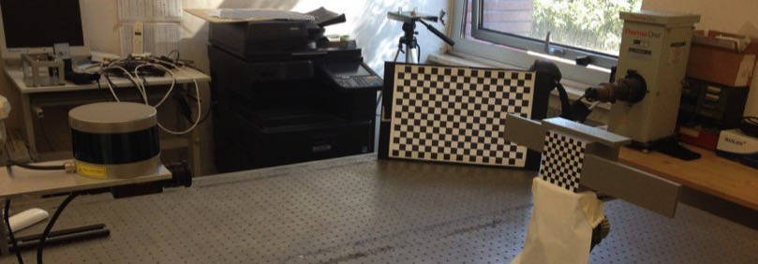
Autonomous GNC for future space operations
Project Title | LIDAR-based relative navigation for debris removal (2013-ongoing) Internal funds
Architecture capabilities
Pose determination algorithms
Unscented Kalman Filter
Target Inertia properties estimation
Numerical simulation environment
In-house experimental testbed

Slide 24
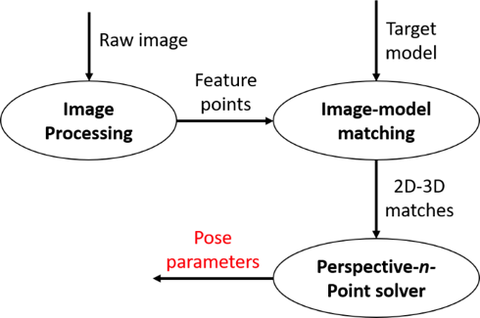
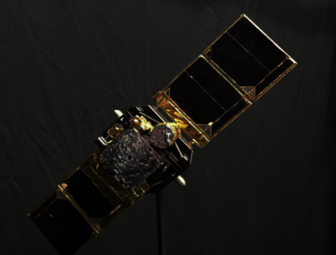
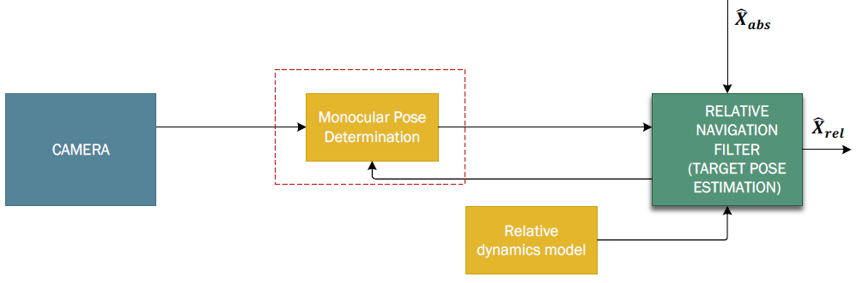
Autonomous GNC for future space operations
Project Title | VISION-AIDED NAVIGATION ASSISTED BY GNSS (2015-2019) – ASI funded
Partners → TSD (prime), POLIMI, CIRA, UNICAL, ST
Project goal→ Development & test of highly-integrated system for autonomous navigation in OOS/ADR mission scenarios
UNINA role → Development & test of camera-based pose determination algorithms
HWIL experimental campaign
Model-based algorithms are used for both pose initial acquisition and tracking.

Slide 25

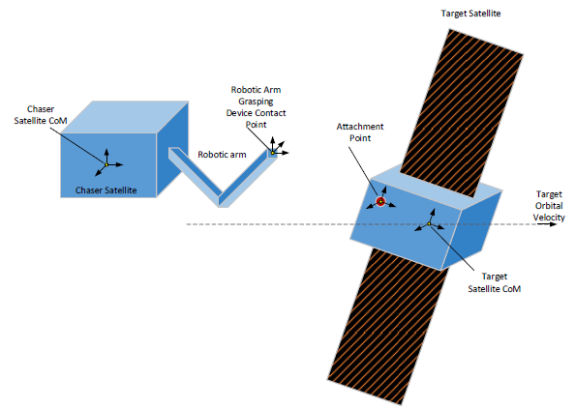
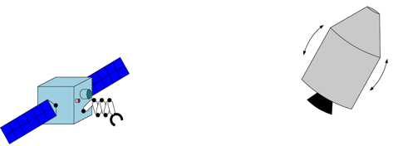
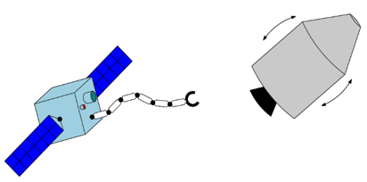
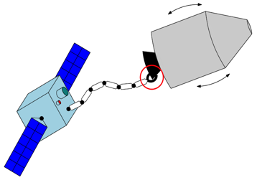
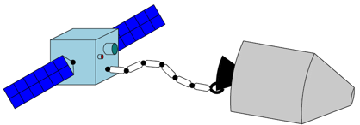
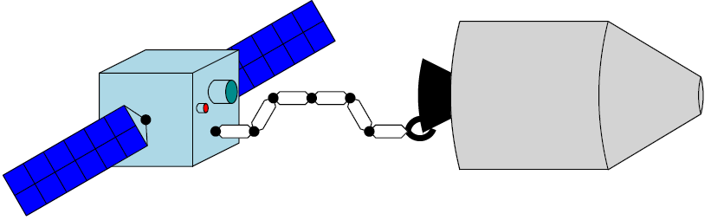
Autonomous GNC for future space operations
Project Title | Preparation of Enabling Space Technologies and Building Blocks: GNC and Robotic Arm Combined Control (2020-ongoing) ESA funded
Joint study by three Italian universities
Goal → Address technical challenges related to the approach, capture and stabilization of a space target by a chaser equipped with a robotic arm in the frame of OOS (On-Orbit Satellite services) and ADR (Active Debris Removal) scenarios
Reach and capture
Initial conditions
Approach
5-10 m
Stack
Rigid connection
Stabilization after capture
Stabilization and detumbling
Attitude control of the stack

Slide 26
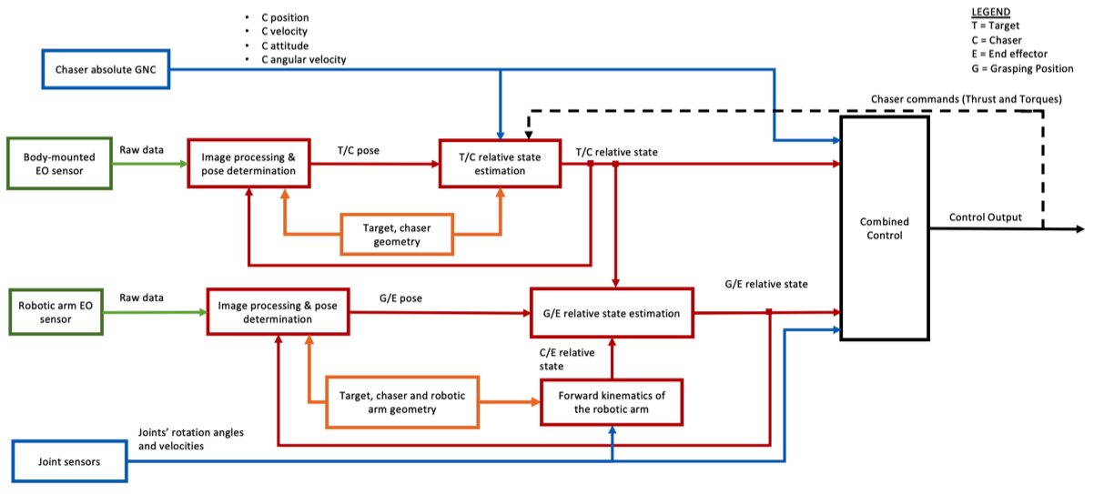
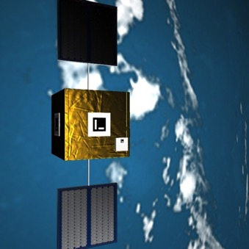
Autonomous GNC for future space operations
Project Title | Preparation of Enabling Space Technologies and Building Blocks: GNC and Robotic Arm Combined Control (2020-ongoing)
UNINA role → Development of a relative navigation architecture able to estimate the relative state between
the Target and Chaser main bodies
the robotic arm end effector and the grasping point on the target surface

Slide 27

Space Missions Based on Small and Micro Platforms
Project Title | FORmation flying of CubEsat assemblies for remote sensing (2020-ongoing) – MUR Funded (PON Actions)
CubeSat formation in dawn/dusk SSO orbit
FF-SAR based on more Cubesat-based platforms
Each platform has a modular architecture: bus is an assembly of Cubesat Units
System design also inspired to a fractioned architecture (distribution of functions)
Illuminator
Three identical platforms separated by 200-300 m flying in coordination with an illuminator of opportunity with a separation of 100 km

Slide 28
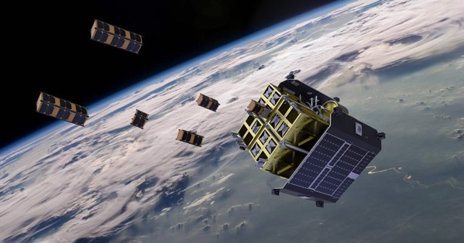
Space Missions Based on Small and Micro Platforms
Project Title | FORmation flying of CubEsat assemblies for remote sensing (2020-ongoing) – MUR funded (PON Actions)
FORCE Satellite Layout
Modular design realized by combining several modules each composed by a few Us (Plug and play philosophy). Orbit deployment with ION Satellite Carrier (operated by D-Orbit)
Sat.1
Sat.2
Sat.3
Antenna Module
Propulsion Module

Slide 29
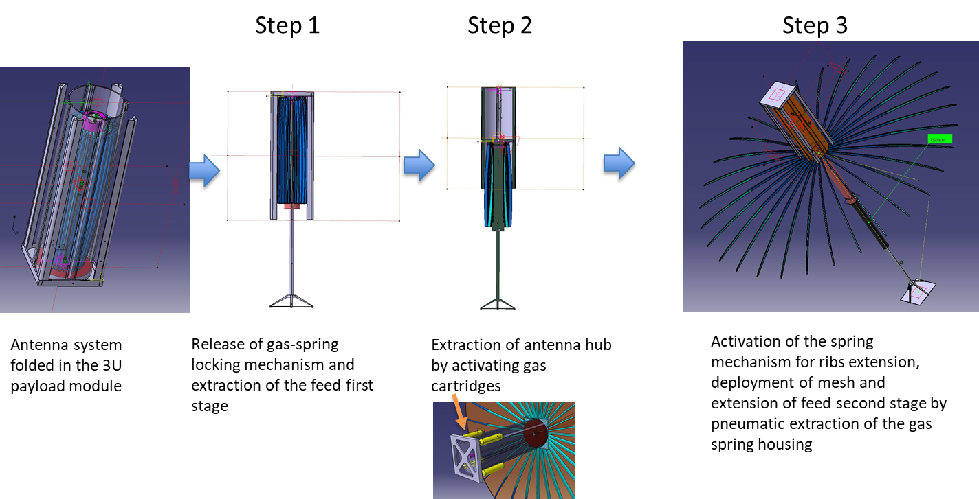
Space Missions Based on Small and Micro Platforms
Project Title | FORmation flying of CubEsat assemblies for remote sensing (2020-ongoing)
FORCE Antenna Module

Slide 30
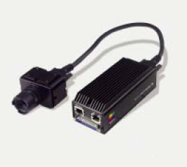
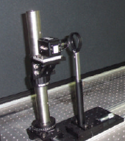
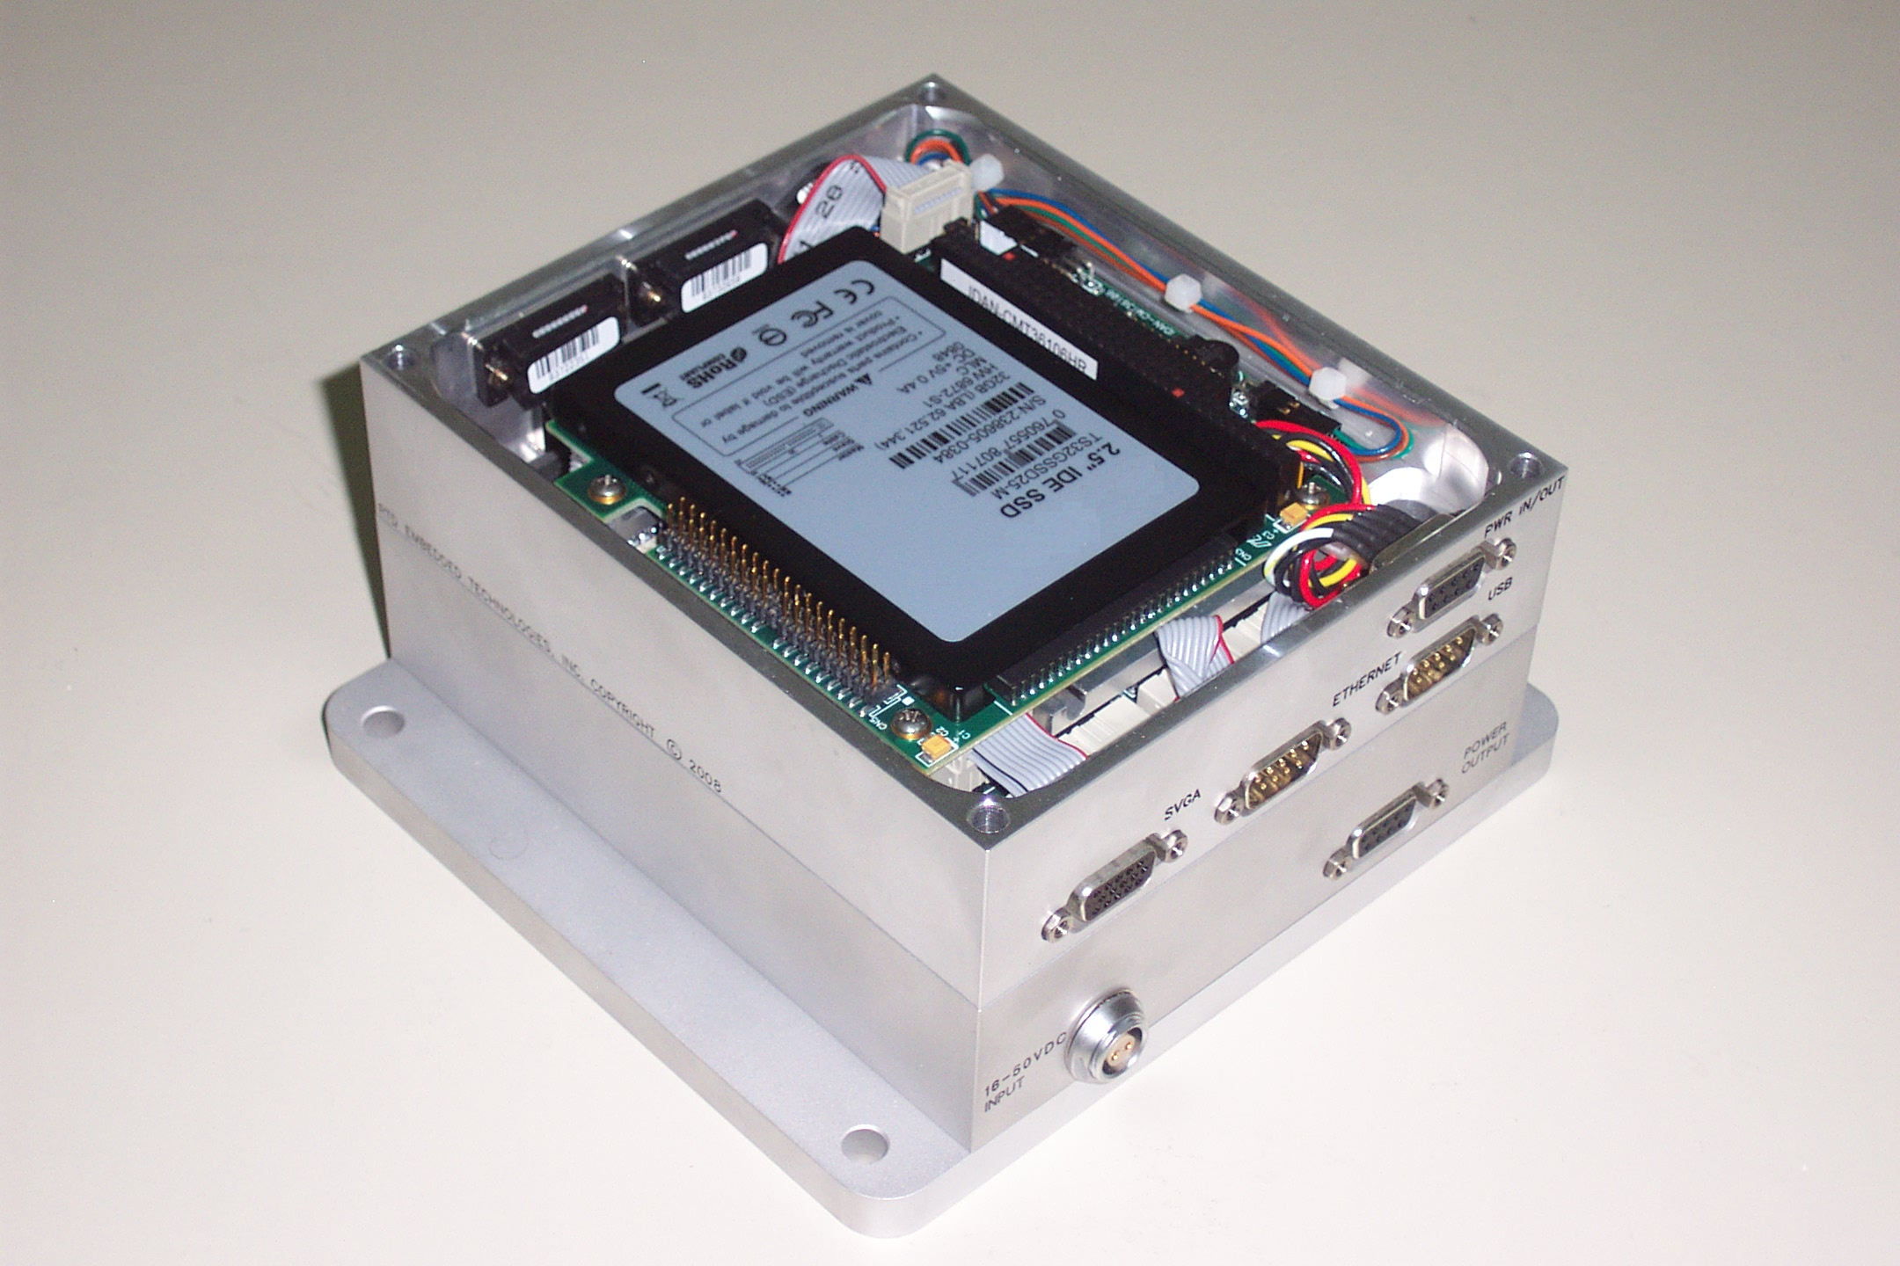
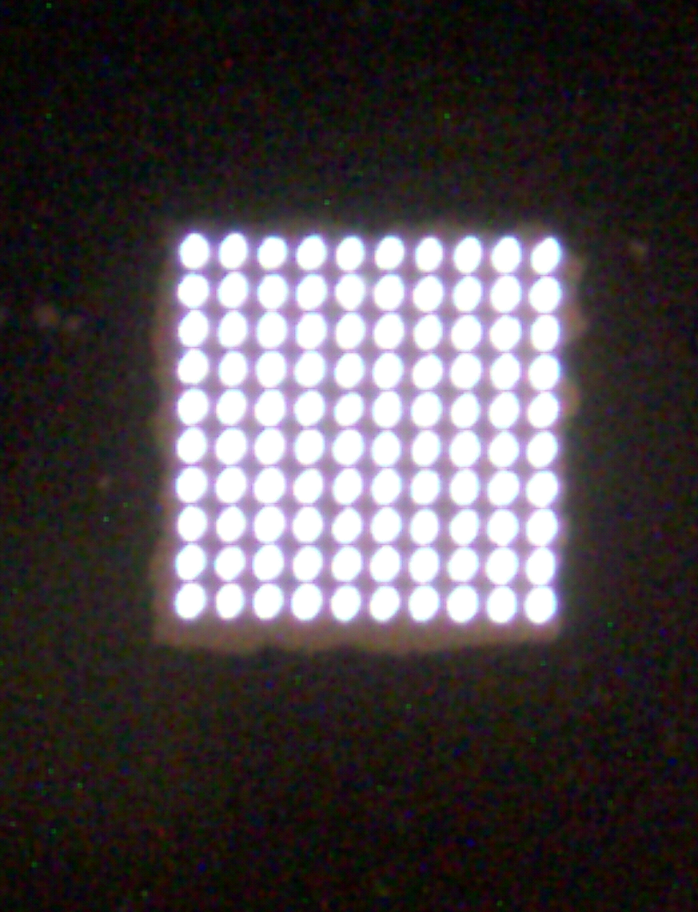
COTS- Based Micro Sun & Star Sensor
COTS-based sun sensor prototype (ASI funded)
APS detector
Multiple aperture: thin foil of steel (thickness 0.1mm); 10x10 array of tiny holes (0.1-mm radius)
Real-time processing by pc-104 single-board computer, designed for harsh environment
Wide FOV, with variable number of sunspots:
from 34°x16° to 90°x80°
Neural-network-based Calibration Function
High precision, < 5 arcsec at large off-boresight angle
COTS-based star sensor prototype (Regione Campania funded)
Initial acquisition/Attitude tracking/High-rate mode
Full Performance: accuracy <<0.01°
Matrox IRIS: camera head + embedded processor
Test Campaigns (Dedicated Laboratory Test Facility)

Slide 31
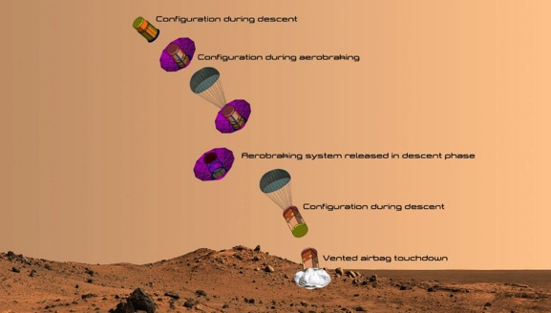

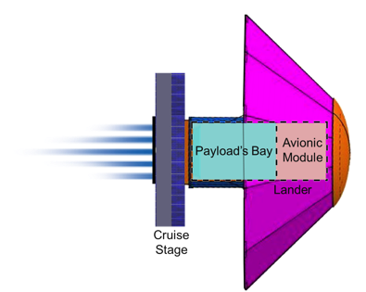
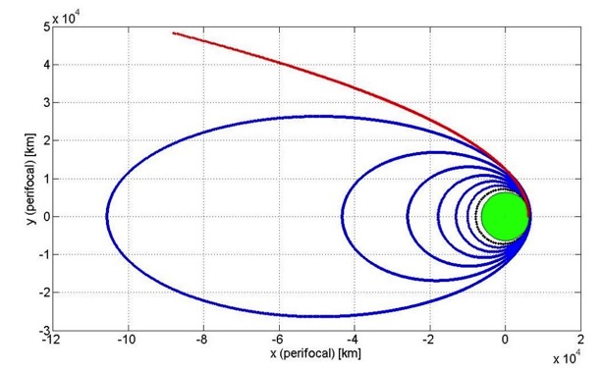

SMS – Small Mission to Mars
(ESA General Studies Program)
Modular design exploited for SMS, three main elements:
Lander Module, which includes the payload module and the avionics module (about 1.6 x 0.8 m) ;
Deployable Heat Shield, for deceleration and thermal protection during EDL
Cruise Stage, for the interplanetary trip up to MARS atmospheric entry
Mars EDL
Mars Arrival
Launch and insertion into transfer orbit
Interplanetary cruise

Slide 32


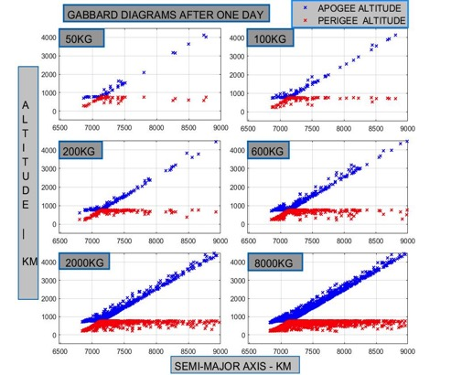
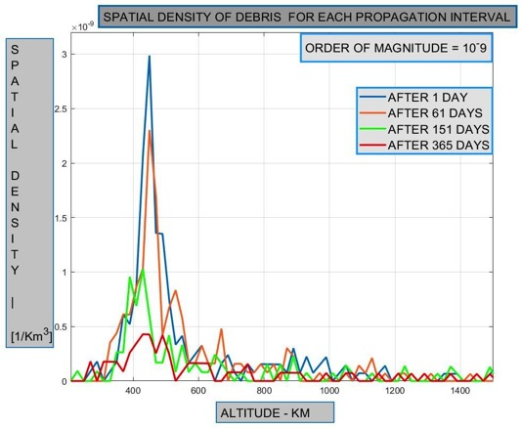
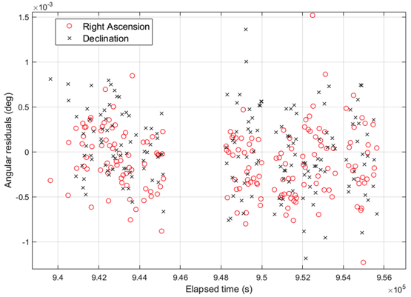
Space Situational Awareness/Space Surveillance and Tracking
Collaboration with the Italian SST Operations Center (Italian Air Force) and with Vitrociset, within several research projects (2020 – ongoing)
Development of algorithms and software tools
  Fragmentation analysys: modeling of collision/explosion events
  Objects propagation
  Collision risk analysis
  Sensor calibration
  Space object characterization

Slide 33
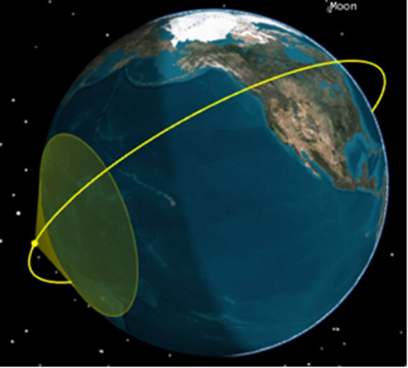
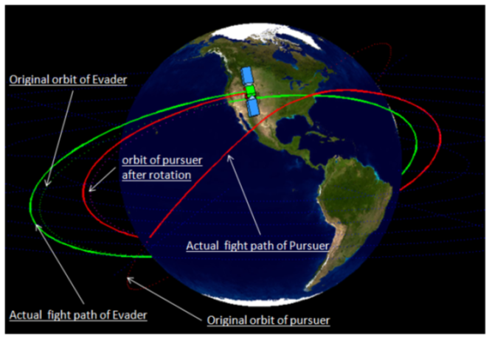
Space Situational Awareness/Space Surveillance and Tracking
Project Title | INTEGRAL - Innovative and iNteroperable Technologies for spacE Global Recognition and Alert (2021-ongoing) - EDA funded
Development of a Recognized Space Picture and a space intelligence capability, based on functions and services deployed through a European military SSA Command and Control system
Collaboration within a large consortium including all main European players in the SSA field
Unina role mainly linked to space picture assessment and satellite operational status analysis
Emphasis on Machine Learning approaches

Slide 34
Research Activities
UNMANNED AERIAL SYSTEMS
Advanced avionics and payloads for UAS
Autonomous take-off and landing systems
Detect and avoid architectures and algorithms
Autonomous GNC for UAS and re-entry vehicles

Slide 35
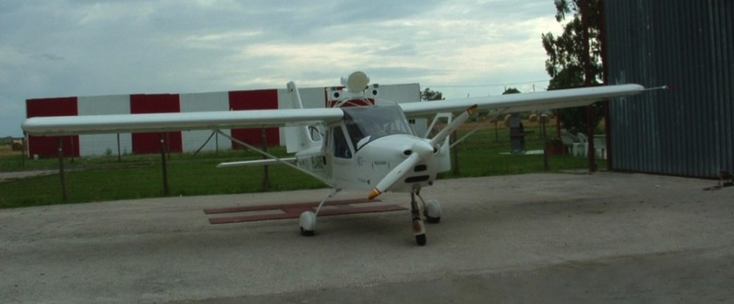

Sense and Avoid
Activities carried out within project TECVOL in collaboration with the Italian Aerospace Research Center (CIRA)
Radar/EO data fusion architecture based on:
  Sensors’ hierarchy (radar as main sensor)
  Central-level fusion (minimally pre-processed measurements)
  Extended Kalman filtering
  Cross-Sensor cueing
COTS-based approach for flight demonstration (optionally piloted aircraft)
Flight demonstration of:
  Real time radar-based detection and tracking
  Real time multi-sensor-based detection and tracking
  Autonomous non-cooperative collision avoidance
  Vision-based detection and tracking (off-line based on flight data)

Slide 36


Sense and Avoid – Flight Results
AVOIDANCE MANEUVER INITIATED

Slide 37

Sense and Avoid – Flight Results

Slide 38


Sense and Avoid

Slide 39

Sense and Avoid

Slide 40





Very Low Altitude Sense and Avoid
(Small UAS / Urban Air Mobility /Advanced AM)
Innovative vision-based techniques
Radar-based sense and avoid with compact radars (meta-material based)
Radar/EO fusion on small UAS
Emphasis on flying obstacles

Slide 41
GNC for cooperative multi-UAV systems
Cooperative planning, guidance, and navigation to overcome single vehicle limits in small UAS / low altitude applications
Focus on outdoor missions
Integrated approach, several (interconnected) research paths:
  Improvement of navigation performance (attitude) under good GNSS coverage
  Improvement of navigation performance in GNSS challenging environments
  Cooperative guidance
  Relative (visual) sensing
  (Multi-UAV) navigation aware path planning
    To enable formation flight when needed
    To optimize task assignment also in the case of heterogeneous fleets (link with U-Space/UTM)

Slide 42





Ultralight radar for small UAS / UAM
Radar-aided odometry and navigation
Raw data
Estimated UAV motion
Surface/sub-surface radar imaging via tomographic techniques
(collaboration with CNR IREA)

Slide 43




Ongoing projects
Project Title | CREATEFORUAS - Cooperation and REliable Autonomous TEchnologies to Foster Operations Relying on Unmanned Aircraft Systems (2019-ongoing) – MUR funded (PRIN Programme)
Research areas
  AI-powered vision
  Sense and Avoid
  Robust control
  Multi-UAV Cooperation
Cooperative navigation concept
Meter-level positioning error with poor GNSS coverage

Slide 44









Ongoing projects
Project Title | AMPERE - Asset Mapping Platform for Emerging Countries Electrification (2020-ongoing) – funded by EUSPA (EU Agency for Space Programme - Horizon 2020 Programme)
AMPERE project: cloud-based platform for electrical asset mapping and inspections, powered by field data acquired with small UAS
  focus on emerging countries and Galileo as key enabler
Unina main roles:
  Development and calibration of the multi-sensor-payload, post processing with emphasis on Lidar data and Lidar/optical fusion
  Demonstration of multi-drone cooperative navigation concept (CDGNSS/Vision) for improved mapping products

Slide 45






Ongoing projects
Project Title | SMARTGO - gnsS enabled urban air Mobility through Ai-powered environment-awaRe Techniques for strateGic and tactical path planning Operations (2021- ongoing) – funded by the Italian Space Agency
Development of multi-objective strategic and tactical path planning strategies for Urban Air Mobility scenarios (drone delivery, air taxi, etc)
Management of multi-dimensional maps and information sources (GNSS coverage, risk, weather, …)
Integration of the path planning architecture and algorithms within the U-Space framework

Slide 46


LIFT laboratory
LIFT - Laboratory for Innovative Flight Technologies
Several drone activities are carried out at the Laboratory for Innovative Flight Technologies (LIFT) located at Centro Servizi Metrologici e Tecnologici Avanzati (CESMA) within UNINA San Giovanni a Teduccio facility.
LIFT is a recognized drone operator with a field test facility and a netted area under construction.
The center is dedicated to Research but also to Technology Transfer activities involving the use of drones and other (mostly) aerospace systems.

Slide 47








LIFT laboratory
LIFT Projects and activities:
Drone-based Monitoring Activities for Covid-19 Emergency multi-disciplinary management:
  Vital Signs Monitoring
  Goods Transportation
  Spray Diffusion
FOCUS, multi-disciplinary study of drone interactions with birds (in particular seagulls)
GANNET, in cooperation with local SMEs
  realization of mini UAS (MTOW <= 150 kg) by exploiting low-cost process of ULM aircraft;
  Onboard FMS and Inertial Unit will be realized in custom configuration
Trajectory prediction for UAS integration in civilian airspace
  Machine Learning approach
Innovative integrated navigation systems
  advanced MEMS inertial devices
  custom auxiliary solutions including bio-inspired systems (polarization camera).
Underwater autonomous systems (ROV-AUS)
  Challenging navigation (GPS signal not available)
  LiFi Optical communications (short range)
Angle of Polarization
Polarization Camera

Slide 48







LIFT laboratory
LIFT Projects and activities (continued):
Support to railway engineering and infrastructure monitoring (cooperation with Hitachi Railways, EAV)
Support to local government agencies for environment pollution management
SISTS, full development of a mini-UAV aimed at in-flight demonstration of transmitting the UAV-captured video stream to a remote Control Center by exploiting a mobile Ground Station as transponder for Satellite Communications (financial support of Italian Ministry of Defense, cooperation with Leonardo)
Drone swarm design
Drone swarms as countermeasures against ground-based-radar detection
(cooperation with the Aeronautical and Space Test Division of the Italian Air Force )
Reconstructed 3D model

